Slide 1
Agenda Day 1
Introductions
Blockchain 101 / Use Case
Problem Statement Validation
Stakeholder Analysis
Empathy Mapping
Lunch
As-is Scenarios
Pain Points & Opportunities
To-be Scenarios

Slide 2
Blockchain 101 + Use case
Notes:
See what Becket has

Slide 3
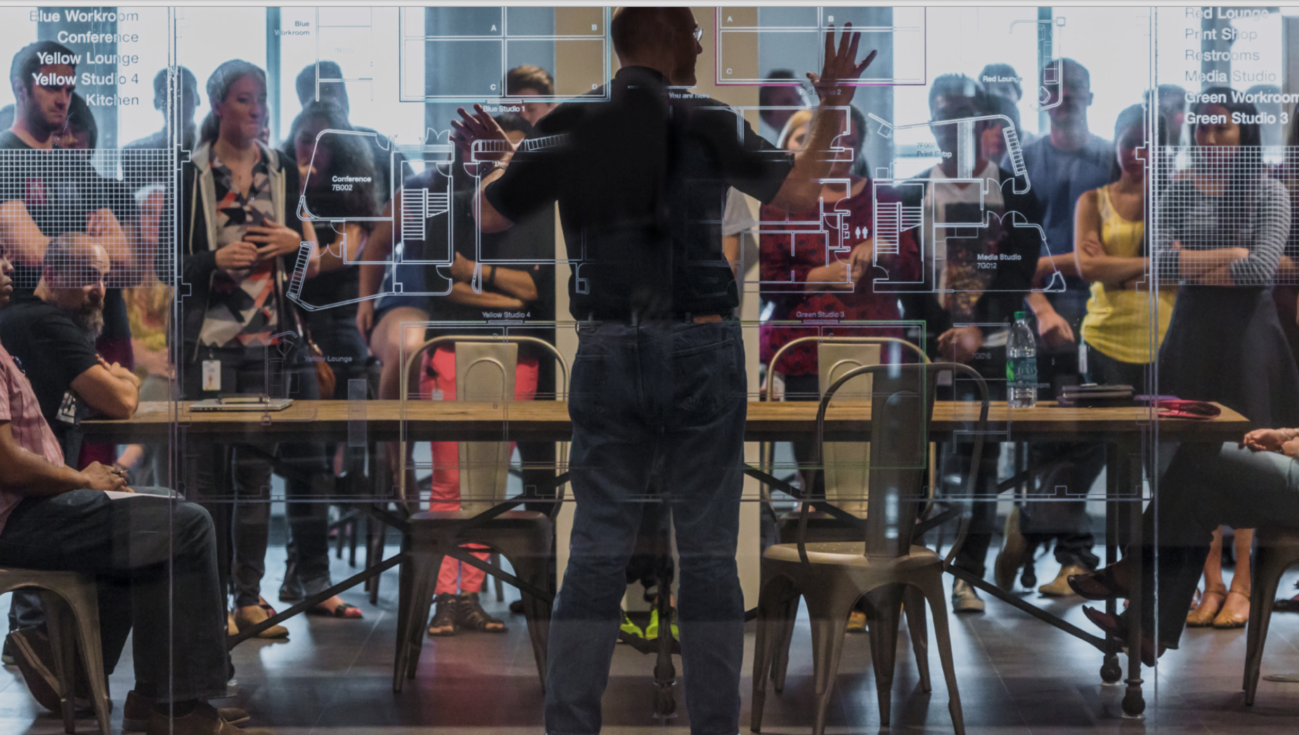
Design Thinking at IBM

Slide 4
Goal of the Sessions Identify the core experience of a better transfer process

Slide 5
IBM Design Thinking Ground Rules
Start on time
Laptops closed, phones away
Less talking, more writing
Less writing, more drawing
Everyone has a Sharpie
Quantity over quality
Encourage the absurd
Don’t be seduced by details
Embrace discomfort
Yes! And…

Slide 6
What is IBM Design Thinking?

Slide 7
Design an alarm clock
You have 2 minutes

Slide 8
Design a better way to wake a college student
You have 2 minutes

Slide 9
IBM Design Thinking is a framework for delivering great experiences for your users.

Slide 10

…this is a user experience
Notes:
But what if we were asked to design a better way to experience coffee?
Would we decide to focus on quality in a retail setting, and hire baristas instead of waiters?
Would we think about an ecosystem where each individual sharing the coffee maker could brew to their own preferences, like a Keurig?
If you approach things from a pure engineering perspective, you get features. And you rarely get something new or unique.
If you think about the user experience, you end up with a better solution—and a more satisfied user.

Slide 11

Principles
A focus on user outcomes
When you use IBM
Design Thinking, put your users’ needs first.
Multidisciplinary teams
Collaborate across disciplines to move faster and work smarter.
Restless reinvention
Everything is a prototype. Listen, learn, and course-correct.
Notes:
Restless reinvention
Everything is a prototype. Everything—even in-market solutions. When you think of everything as just another iteration, you’re empowered to bring new thinking to even the oldest problems.
Solve old problems in new ways
Human needs don’t change but the ways we address them do. For example, we’re still improving the way we get from Point A to Point B. From this perspective, yesterday’s horse-drawn carriage was a prototype for today’s automobile. Today’s automobile is yet another prototype for tomorrow’s transportation breakthrough.
The problem is defined by the fundamental human need to get from A to B, not the point-in-time implementation—in this case, the car.
A truly adept team constantly refreshes their understanding of the fundamental human need and of the changing technologies available. This logic applies at many timescales: day to day, month to month, year to year.
A progression of circles filled in
Bias toward action
Sometimes, you’ll have to commit and release an iteration at a deadline beyond your control. Other times, you’ll have to use your judgement to know when your iteration is ready for release. Recognize that from the perspective of your users, no solution is perfect.
When you use IBM Design Thinking, your bias is toward action. You will pursue perfection with the humility of knowing that in the fullness of time, nothing is actually perfect. That is: everything is a prototype.

Slide 12
The Loop
Observe
Get to know people, uncover their needs, test your ideas.
Reflect
Build understanding, form intent, commit to decisions.
Make
Explore ideas, prototype possibilities, drive outcomes.
Notes:
Restless reinvention
Everything is a prototype. Everything—even in-market solutions. When you think of everything as just another iteration, you’re empowered to bring new thinking to even the oldest problems.
Solve old problems in new ways
Human needs don’t change but the ways we address them do. For example, we’re still improving the way we get from Point A to Point B. From this perspective, yesterday’s horse-drawn carriage was a prototype for today’s automobile. Today’s automobile is yet another prototype for tomorrow’s transportation breakthrough.
The problem is defined by the fundamental human need to get from A to B, not the point-in-time implementation—in this case, the car.
A truly adept team constantly refreshes their understanding of the fundamental human need and of the changing technologies available. This logic applies at many timescales: day to day, month to month, year to year.
A progression of circles filled in
Bias toward action
Sometimes, you’ll have to commit and release an iteration at a deadline beyond your control. Other times, you’ll have to use your judgement to know when your iteration is ready for release. Recognize that from the perspective of your users, no solution is perfect.
When you use IBM Design Thinking, your bias is toward action. You will pursue perfection with the humility of knowing that in the fullness of time, nothing is actually perfect. That is: everything is a prototype.

Slide 13
The Keys
Hills
Align your team around specific, worthwhile outcomes to achieve.
Playbacks
Reflect together in a safe space to give and receive criticism.
Sponsor Users
Give users a seat at the table. Invite them to observe, reflect, and make with you.
Notes:
The Keys
If every problem could be solved by a handful of people, the Loop would be enough. But in the real world, complex problems call for complex teams.
Scaling design thinking
To go beyond intent and deliver real outcomes, design thinking needs to work at scale. The Keys to IBM Design Thinking are our three most important techniques for scaling design thinking to complex teams and projects. Though they’ve been honed through our experience with larger teams, we’ve found these techniques to be invaluable for teams of all sizes. They help us not only design, but deliver meaningful outcomes—or in our own words, “take those Hills.”

Slide 14
Problem Statement Validation
Notes:
See what Becket has

Slide 15
How might…
we design a better ____________________________________________
Notes:
See what Becket has

Slide 16
Stakeholder Analysis
Notes:
See what Becket has

Slide 17
Who are our stakeholders? What do they need from us? What do we need from them? What are some of their current challenges?

Slide 18
Now, let’s detail the situation each of these stakeholders is facing and look at the things that are getting in the way of their success.

Slide 19
Stakeholder Analysis
Diverge on identifying stakeholders, one per sticky note. “Stakeholders” can include teams, team roles, project leads, executives, partners, customers, and end users.
For each stakeholder, add a second sticky note with a quote expressing their thoughts, opinions, or expectations.
In parallel, cluster stakeholders and label the groups.
Draw and label lines among groups representing relationships such as influence, process, or dependencies.

Slide 20
Break

Slide 21
Users and Personas

Slide 22
Personas
Created from primary research with real people
Take the form of a narrative description of a single person, who represents a behavioral segment
Hypothetical―BASED ON REAL PEOPLE…but not real people
Used to guide the creation of solutions, products, and messaging
Represent common, significant use patterns
Represent models of the key behaviors, attributes, motivations, and goals of a prospective user

Slide 23
Your Users ≠ You Your Users ≠ Product Manager Your Users ≠ Engineer Your Users ≠ Design Lead Your Users ≠ Manager Your Users ≠ Executive Your Users ≠ Buyer Your Users ≠ Implementer

Slide 24
Why user research?
Buyer
Implementer
This looks like all the features they’ll need to do the work
Okay, I’ll set it up for everyone
User
How do you use this thing?

Slide 25
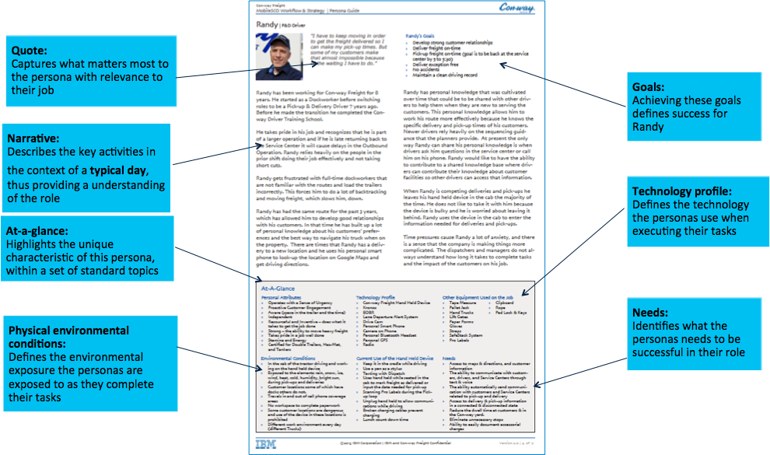
Notes:
This is an example of a complex persona. It was created through in person observation and interviews and took close to 40 hours to complete.
Not all personas must be this complex.
Important callouts to draw attention to is the Goals, Needs, and the Environmental Conditions of this persona. Where people perform their tasks is critically important when designing for mobile. Inside, Outside, bright light, dark rooms, standing, walking, etc . . .

Slide 26
Our Proto-Personas
Gaining Agency | Losing Agency | Payroll Provider | OPM
GSA HR Specialist | OPM HR Specialist | GSA Payroll Analyst | OPM HR Data Analyst (primary persona)
GSA Manager | OPM Manager

Slide 27
Empathy Maps

Slide 28
What opportunities are presented when we understand our users and their work?

Slide 29

Quotes
Expectations
and Reactions
What do they say or need to say to others? How do they likely express themselves?
What do they think about the situation? What is their viewpoint?
Says
Thinks
Does
Feels
What do they do to get their job done?
How does this person feel about their job?
Actions
Values
Notes:
What is this person saying, thinking, doing, and feeling about their job.
The left side of the matrix represents the things that are observed, while the items on the right represent the items that are inferred.
Body language can go a long way to help us infer what the user is thinking or feeling.

Slide 30
Develop Empathy Map (Teams)
Time: 30 minutes
Develop an empathy map for your
team’s assigned persona
Include description of your persona to share with the group – consider:
Age
Gender
Travel frequency
Occupation
Etc.
Use your flipchart and post-its – one idea per post-it note

Slide 31
Playback
1 minute
Tell us your user’s story
Not too much detail
Don’t read every sticky note
What don’t you know yet?

Slide 32
Lunch

Slide 33
As-Is Scenarios

Slide 34
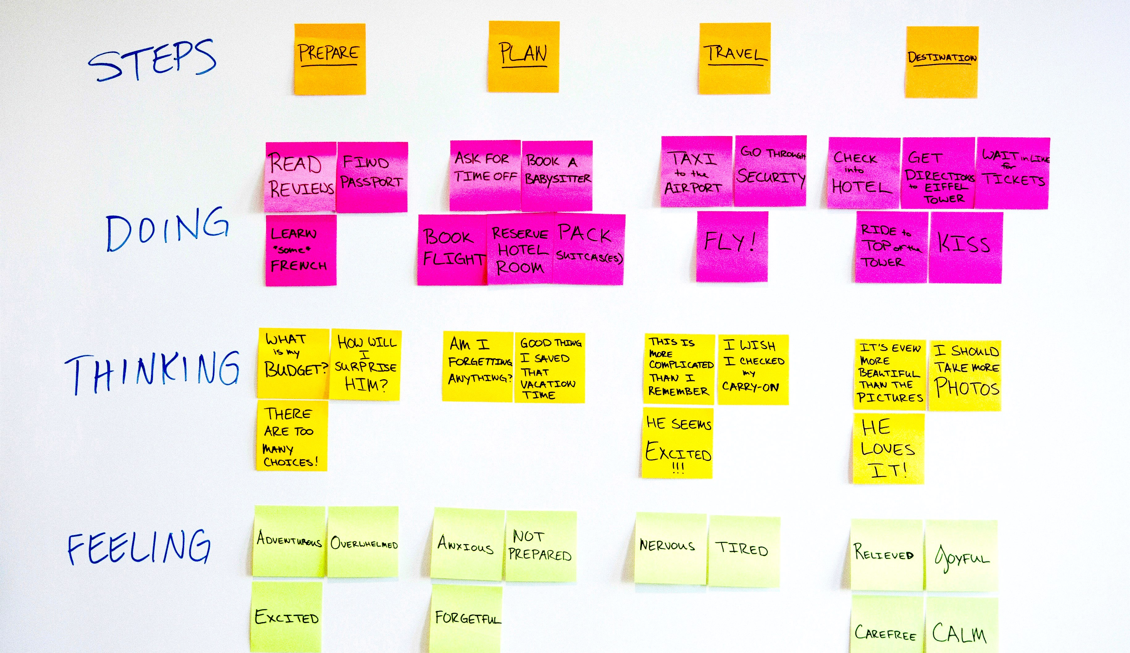
Notes:
We’re going to do that by working-through an exercise known as an AS-IS SCENARIO MAP. (Sometimes these are called “Journey Maps,” or “Experience Maps.)
[EXPLAIN THE MAP’S STRUCTURE]
The point here is to focus on the reality of the CURRENT situation for the user. Be honest. Don’t sugar-coat. Keep it focused on the user’s CURRENT experience.
Remember that interviews shouldn’t be your only source of user research.
Actually observing your users at their work — in the field — is incredibly valuable and insightful!

Slide 35

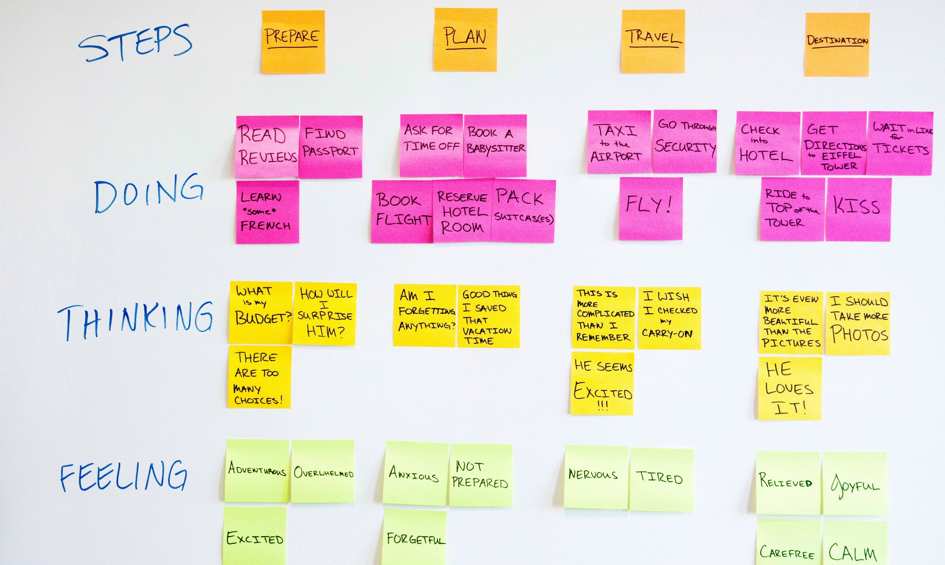



Find Biggest Opportunities for Improvement:
*
*
*
Some good candidates…
“extra” steps
points of inefficiency (doing)
pain points (feeling)
points of confusion (thinking)
IBM Design :: IBM Confidential :: ©2013 IBM Corporation
IBM Designcamp :: IBM Confidential :: ©2014 IBM Corporation
IBM Designcamp :: IBM Confidential :: ©2014 IBM Corporation
IBM Designcamp :: IBM Confidential :: ©2013 IBM Corporation
Notes:
Show the difference between stages, do, think, and feel.
There can be 2 or more tasks (in do) on a single step and some can be combined into a single ‘feel.'
(Clarify what each of the categories are about on a high level)

Slide 36
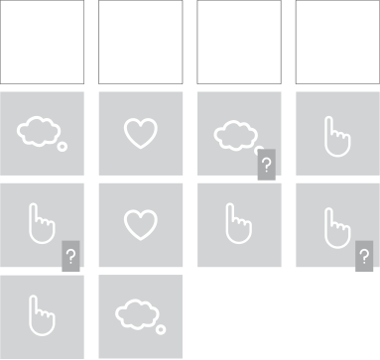
As-Is Scenario Map
Fill in the stages, one per note.
In parallel, team members should begin annotating each column with what the user is doing, thinking, and feeling in each step
Label unknowns (assumptions and questions) for later inquiry or validation.

Slide 37


Pain Points & Opportunities
Identify pain points for users and opportunities to improve the design.
With your empathy maps and scenarios in sight, write sticky notes identifying prominent pain points. Use a second sticky note color to identify opportunities for the design. Each pain point should have a corresponding opportunity.
Pain point
Opportunity

Slide 38
Playback
1 minute
Tell us your user’s story
Not too much detail
Don’t read every sticky note
What don’t you know yet?

Slide 39
To-Be Scenarios

Slide 40
To-Be Scenario Mapping
To-be scenario maps let teams rapidly ideate on future workflows.
Draw four rows and label each: Phases, Doing, Thinking, and Feeling.
Fill in the phases, one per sticky note. Don’t worry about what the “next phase” is; iterate through the scenario at increasing resolution until you are comfortable with the level of detail.
In parallel, team members should begin annotating each column with what the user is doing, thinking, and feeling.
Label unknowns (assumptions and questions) for later inquiry or validation.

Slide 41
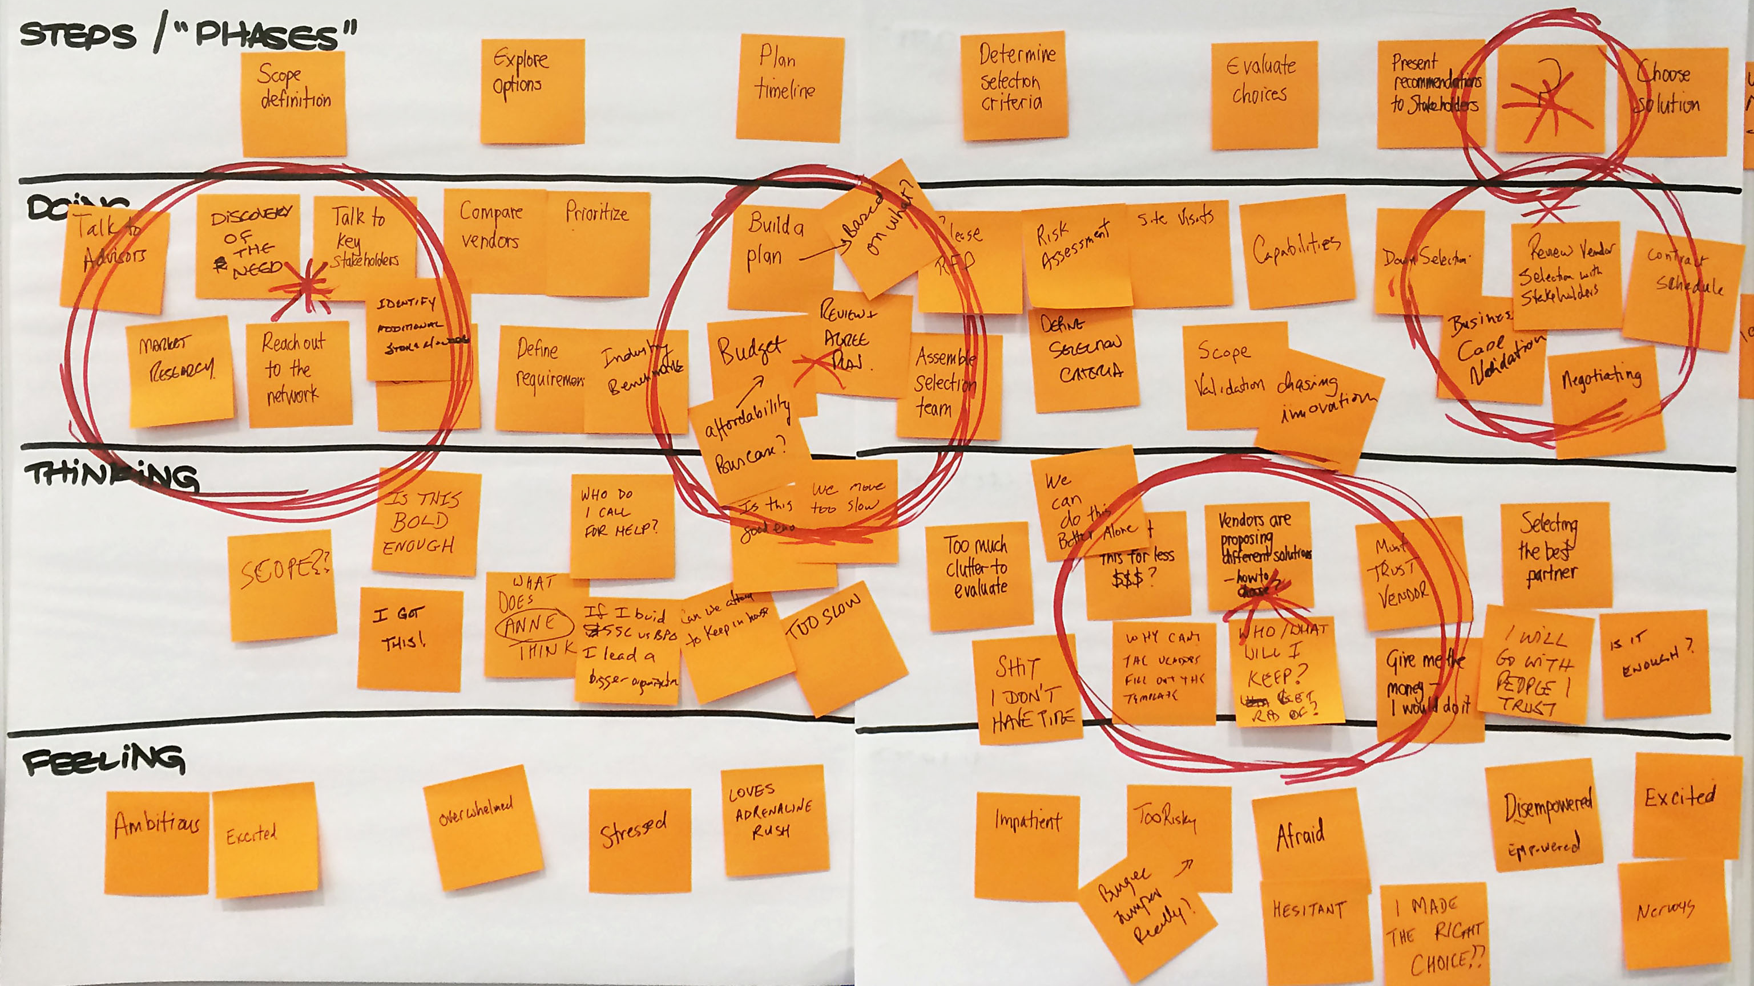
Notes:
This will be a scenario map similar in form to the As-is Scenario Map we did earlier — but now we’re going to build the scenario for what we want it TO BE.
That’s why this is called a “To-be Scenario Map.”

Slide 42
Playback
1 minute
Tell us your user’s story
Not too much detail
Don’t read every sticky note
What don’t you know yet?

Slide 43
End of Day 1

Slide 44
Agenda Day 2
Big Ideas Vignettes
Hills
Subhills
Lunch
Prioritization
Experienced Based Roadmap

Slide 45
Big Ideas Vignettes

Slide 46
What are our big ideas? What might our user’s new experience be like if we successfully implemented our ideas?

Slide 47
Big Ideas Vignettes
On one sticky note, write a brief overview of an idea or solution. Try labeling it with a one- or two-word headline.
On a second sticky note, sketch a visual depiction. Think of this as a single frame of a storyboard — for example, a rough prototype of a user interface or depiction of a user.
Diverge on many of these pairs of sticky notes (called “vignettes”) and quickly share them with your teammates.
Cluster similar ideas and converge on a set that you would like to take deeper using Scenario Maps or Storyboarding.

Slide 48
Break

Slide 49
Hills

Slide 50
Hills
Hills frame your releases around user-centric market outcomes, not feature requests.
Deliver a custom Connections community template to allow agile teams to collaborate on client projects
A Service Line Leader can assemble an agile response team from across IBM in 24 hours without management involvement
(to be delivered by March 2016)
Example from an internal project
Notes:
These are examples of two different hills. One not so good, and one better. What do you notice between the two statements?
The example on the left is hinting at a solution. “A Custom Connections Community.
The example on the right includes a specific user, sets a high level vision, and calls out when this will be complete.

Slide 51
Hills
Hills frame your releases around user-centric market outcomes, not feature requests.
Deliver a custom Connections community template to allow agile teams to collaborate on client projects
Who
What
Wow
A Service Line Leader can assemble an agile response team from across IBM in 24 hours without management involvement
(to be delivered by March 2016)
Example from an internal project
Notes:
Introduce the anatomy of a hill.
Who - About a User or specific classes of Users
What - About a specific problem that has easily understandable and direct value
Wow - Can be taken with this delivery or over a finite, identified set of deliveries
TIP:
Ask if there are designers in the class. Make a joke about APs and Partners always ask for the “Wow factor” “Make it Sizzle” and “give me the wow” is like finger nails on a chalkboard to a designer. But given the the construct of a hill - it solves that problem.

Slide 52
From Hills to Agile
1
Hill
1
Sub Hill
1
Scenario
Epic
Story
2
Scenario
Story
2
Task
Sub Hill
Task
2
Hill

Slide 53
Three, and only three
Notes:
Use the voting dots as a loose guide to roughly plot each idea onto the grid.
Once many items are plotted on the grid, being to discuss with your teammates and reposition them in relation to each other — Do certain items see more impactful than others? Do some ideas seem more feasible than others?
Remember: This is a GREAT reason to do this work in a multidisciplinary fashion — engineers, designers, and offering managers will all contribute important and valid information to these discussions.

Slide 54
Who
What
Wow
A UI developer
A tech seller
A business user
can deploy
create a prototype
run what-if analysis
within 10 minutes!
in real-time with client!
with gigabytes of data!
Specific user or set of users
Specific enablement
Specific market value / differentiation
Notes:
Use the voting dots as a loose guide to roughly plot each idea onto the grid.
Once many items are plotted on the grid, being to discuss with your teammates and reposition them in relation to each other — Do certain items see more impactful than others? Do some ideas seem more feasible than others?
Remember: This is a GREAT reason to do this work in a multidisciplinary fashion — engineers, designers, and offering managers will all contribute important and valid information to these discussions.

Slide 55
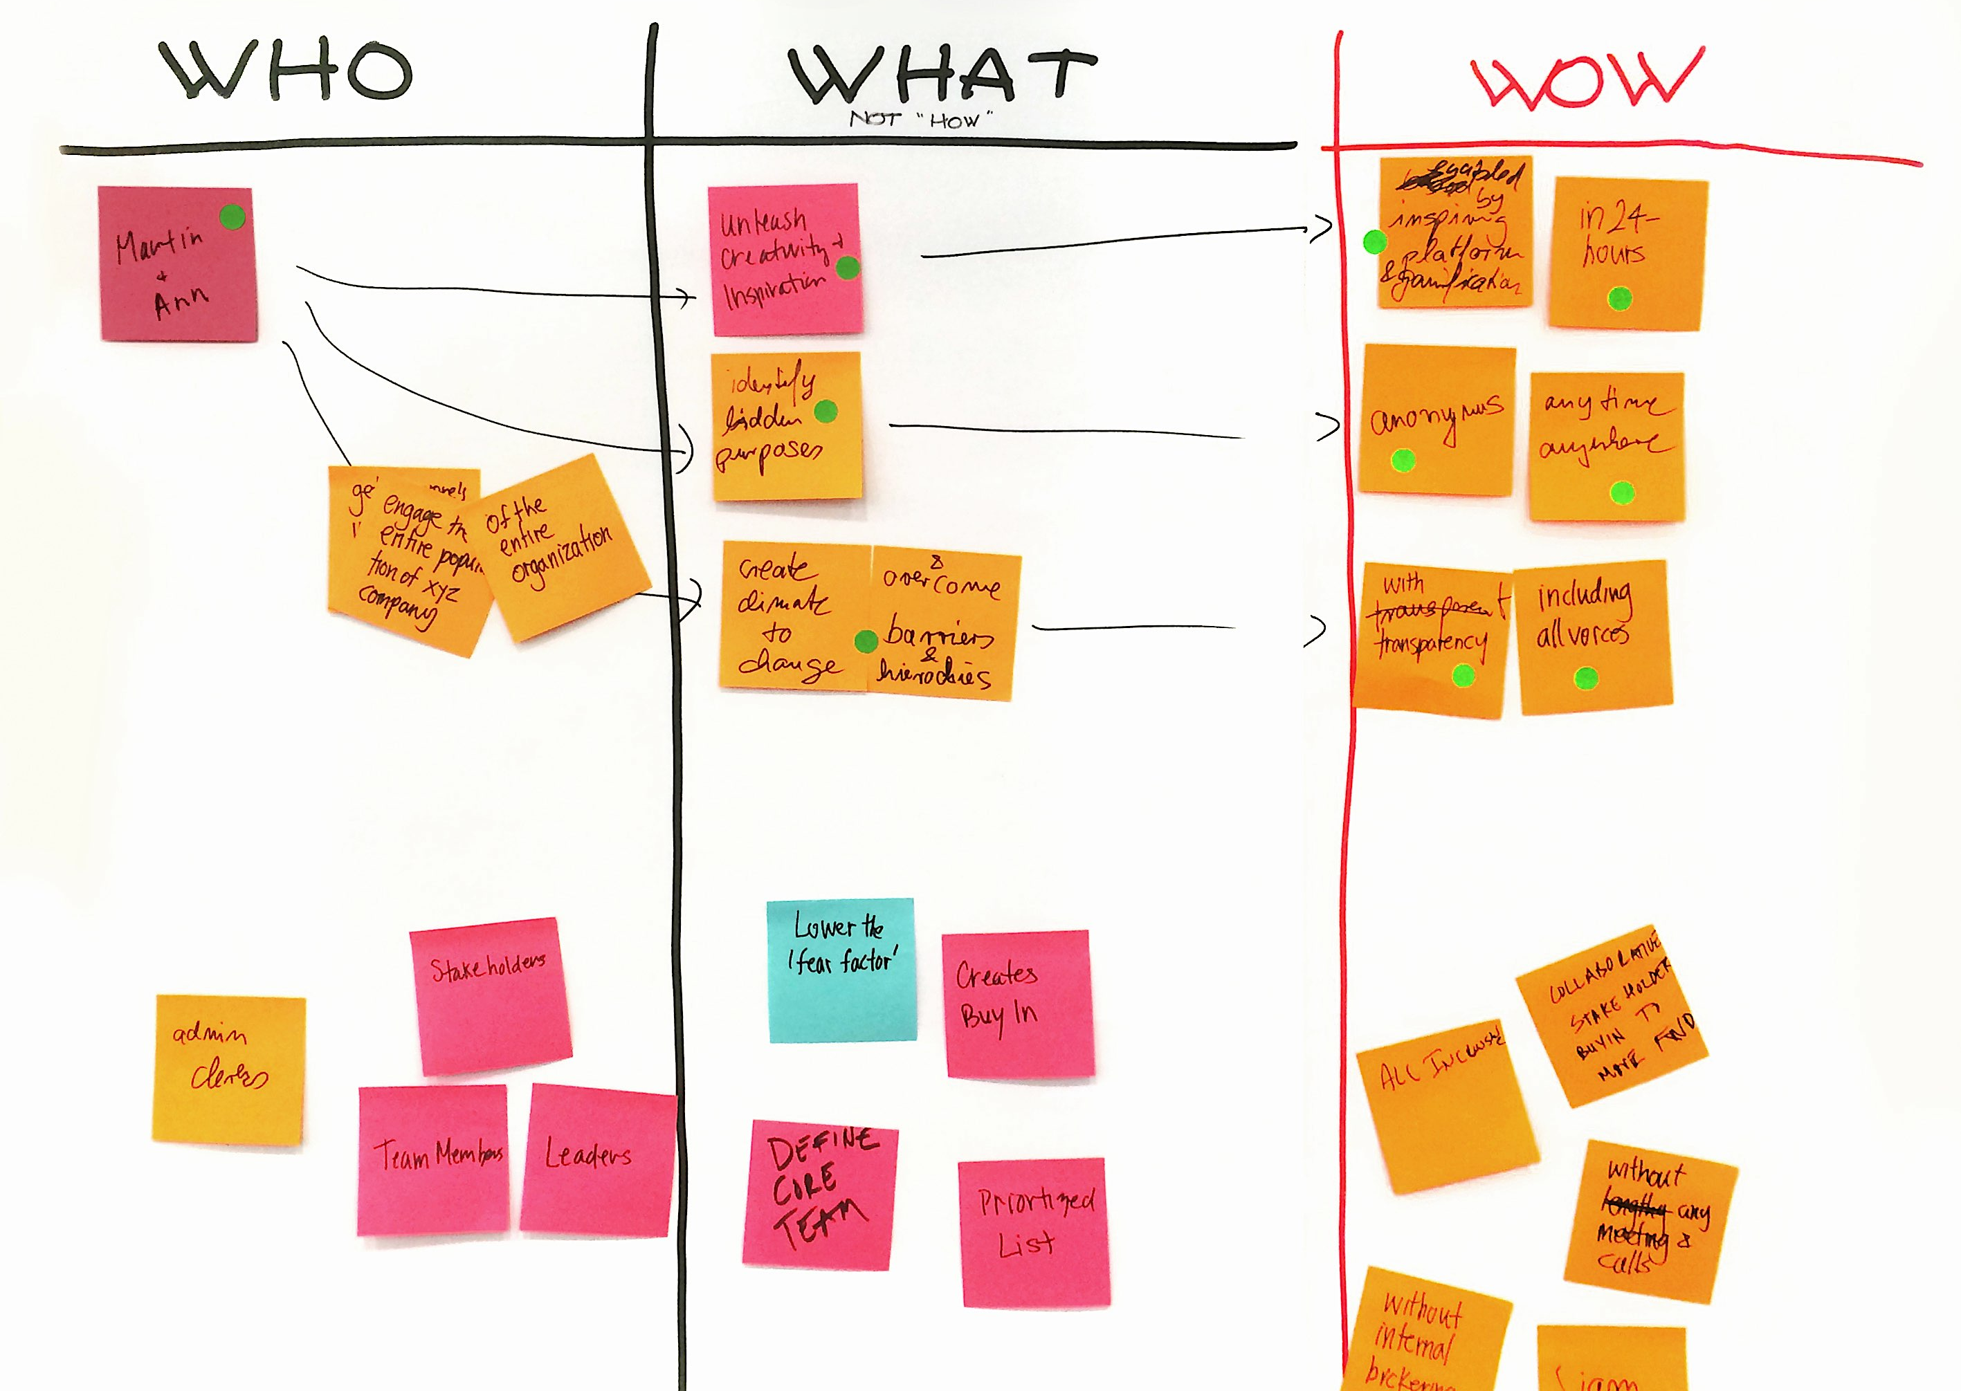
Activity: Hills
Write 3 different Hills focusing on Who? What? and Wow!
Write 3 versions of each hill you just created
Post all of your hills on the large paper
When everyone one in your group is finished discuss your hills
Notes:
Use the voting dots as a loose guide to roughly plot each idea onto the grid.
Once many items are plotted on the grid, being to discuss with your teammates and reposition them in relation to each other — Do certain items see more impactful than others? Do some ideas seem more feasible than others?
Remember: This is a GREAT reason to do this work in a multidisciplinary fashion — engineers, designers, and offering managers will all contribute important and valid information to these discussions.

Slide 56
Sub-Hills

Slide 57
From Hills to Sub-Hills
Sara can have a quick search for all things she wants to buy on the website and get enough information to make a decision
1
Hill
1
Sara can compare the price immediately on the website
Sub Hill
2
Sara can have a quick search for what she wants on the website
Sub Hill
Scenario
Sara searches for what she wants on the website and can receive a good suggestion
1
Epic
Story 1
Sara chooses one dress to put in her shopping cart to compare the price
Story 2
Sara can log in with her account and get personalized information
Task
Register — Account verification
Log in — Account log in
Notes:
NOTE: You can skip this slide if you like. It was added to illustrate how a Hill translates into Epics using a real example.
Hill: Broad capability (vision)
Scenario: CRUD shopping list
Epic: One aspect of CRUD (create, update, manage, delete, approve,…)
Story: Who/What/Why of a feature of the CRUD

Slide 58
Activity: Sub-Hills
Break your hills into to their logical sub-components
Each sub-hill should still have a who, what and wow
Notes:
Use the voting dots as a loose guide to roughly plot each idea onto the grid.
Once many items are plotted on the grid, being to discuss with your teammates and reposition them in relation to each other — Do certain items see more impactful than others? Do some ideas seem more feasible than others?
Remember: This is a GREAT reason to do this work in a multidisciplinary fashion — engineers, designers, and offering managers will all contribute important and valid information to these discussions.

Slide 59
Prioritization Exercise

Slide 60
Exercise: Prioritization I
Importance
Feasability
Evaluate each opportunity quickly and on your own. Vote for the ones that are the most important and feasible
Each person gets 4 votes color 1, 4 votes color 2. Count the votes.
Next we’ll plot them on a grid.
Importance
Does it turn a pain point into a delight?
Does it expand user value?
Does it differentiate the product?
Feasibility
Can we do this as an organization?
Can we take this to market (go-to-market)?
Is it technically feasible?

Slide 61
Activity: Prioritization Grid
high
Using the voting dots as a loose guide, roughly plot each idea onto the grid.
Discuss and reposition ideas in relation to each other.
Do some ideas seem more impactful than others?
Do some ideas seem more feasible than others?
Impact to the user
low
hard
Feasibility for us
easy
Notes:
Use the voting dots as a loose guide to roughly plot each idea onto the grid.
Once many items are plotted on the grid, being to discuss with your teammates and reposition them in relation to each other — Do certain items see more impactful than others? Do some ideas seem more feasible than others?
Remember: This is a GREAT reason to do this work in a multidisciplinary fashion — engineers, designers, and offering managers will all contribute important and valid information to these discussions.

Slide 62
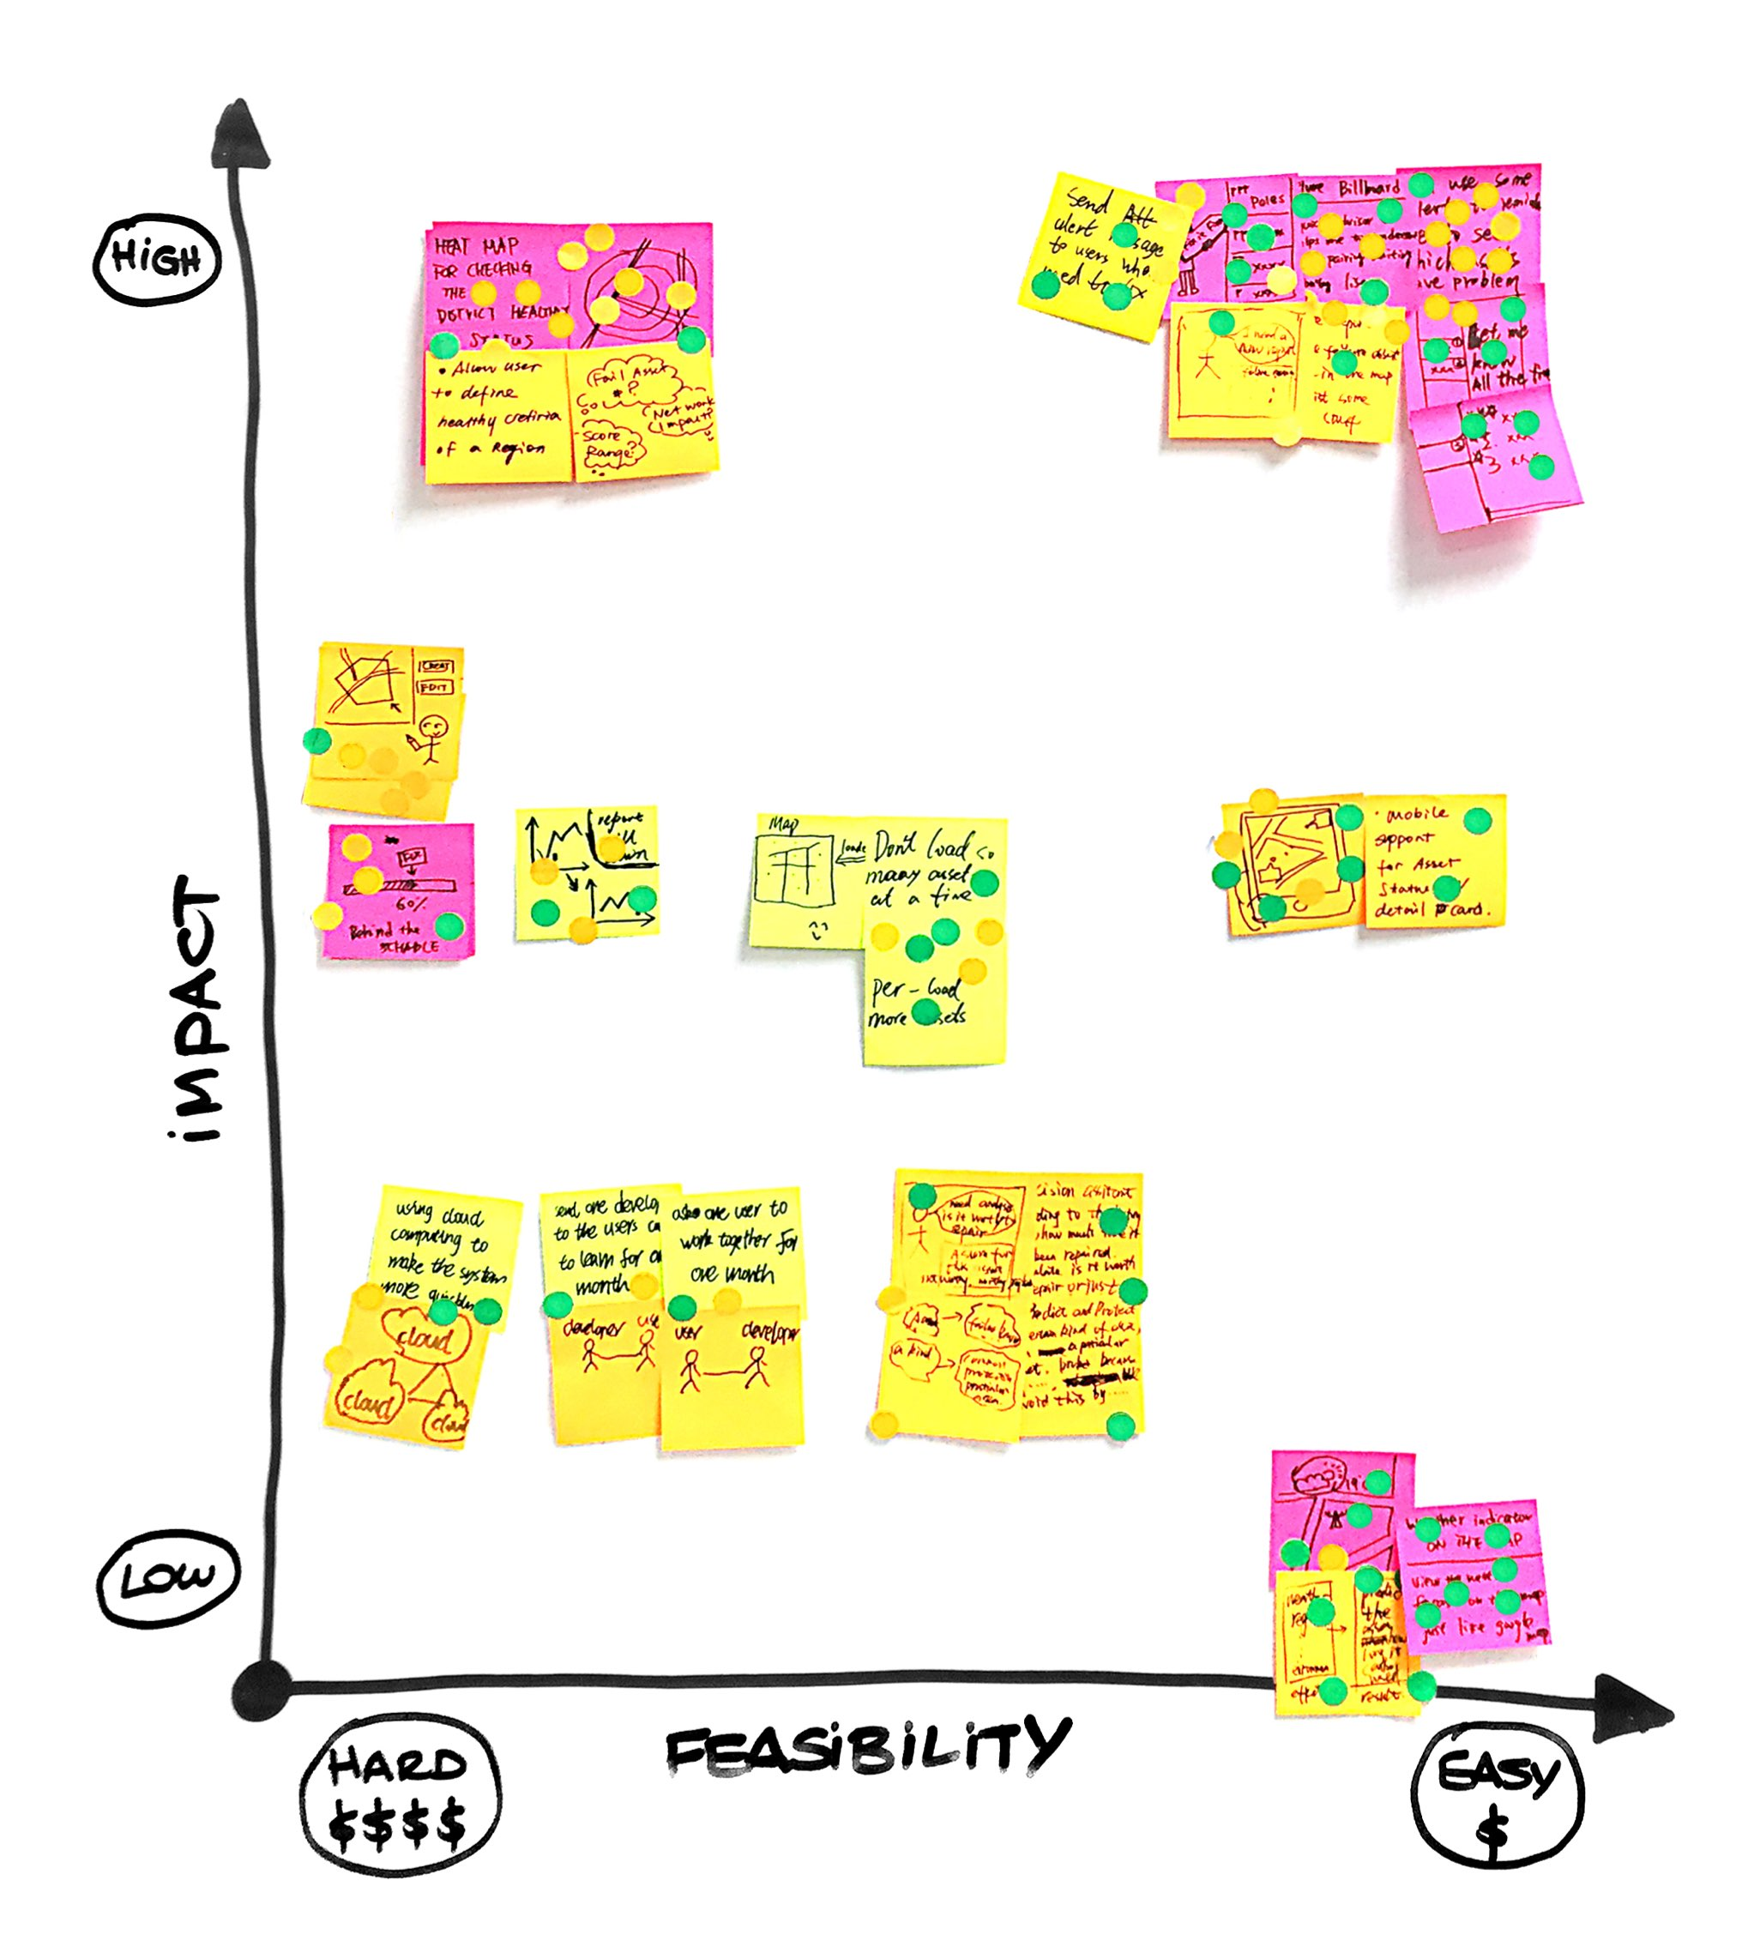
Activity: Prioritization Grid
Using the voting dots as a loose guide, roughly plot each idea onto the grid.
Discuss and reposition ideas in relation to each other.
Do some ideas seem more impactful than others?
Do some ideas seem more feasible than others?
Notes:
Here’s kinda what it will look like.

Slide 63
Activity: Prioritization Grid
high
No Brainers pose the possibility of a tactical advantage
Big Bets can offer strategic differentiation
Utilities may represent table stakes
Don’t waste time or energy discussing Unwise items
Big Bets
No Brainers
Impact to the user
Utilities
Unwise
low
hard
Feasibility for us
easy
Notes:
Your ideas now fall into 4 quadrants.
NO BRAINERS are things that we will most obviously move forward with. It’s not really worth having a long conversation about if we’re going to implement these ideas or not. But it is worth having a conversation about how we can go to market faster or cheaper with these ideas, which would give us a tactical advantage.
But “No brainers” aren’t enough — because our competitors will probably do them, too!
BIG BETS are where we can build our strategic differentiation. UTILITIES are likely table stakes.
It’s worth having a conversation on how we can make the “Big Bets” easier to implement, or how we can make the “Utilities” more impactful to the user.
UNWISE — Let’s not waste our valuable time discussing “Unwise” items now. They’re really difficult to implement and have little value to the user.

Slide 64
Playback
1 minute
Tell us your user’s story
Not too much detail
Don’t read every sticky note
What don’t you know yet?

Slide 65
Roadmapping

Slide 66
Experience-Based Roadmap
Post user enablements onto the map, one per sticky note.
To focus on the user enablement (not on the features), start each note with Can… or Will be able to…
Move the sticky notes in relation to each other on the map to match the journey where they make sense.
As a final step, try to identify and draw three separate columns: Stage 1, Stage 2, and Stage 3.
Note: Stage 1 is the smallest set that demonstrate the vision and can be completed in 5 sprints
Our user can… / will be able to…
Short term
Long term
Notes:
Here’s how to do the activity:
Write the statement, “Our User Can / Our User Will Be Able To…” on top of a sheet of paper.
Label “Short-Term” on the left and “Long-Term” on the right.
Move right to left: begin writing ideas directly related to your vision and plotting them on the LONG-TERM side.
Starting each idea with “Our user can…” or “Our user will be able to…” helps keep the ideas user-focused.
Scope down the Long-Term ideas by asking, “What is the most essential part of this experience?” Plot those ideas near the middle or left-side.
Once many ideas are on the grid, begin to discuss with your teammates and reposition them in relation to each other—do certain ideas need to be implemented in the near-term, or can they wait until a future release?
Allow yourselves the luxury of getting you OWN individual ideas out of your head, onto sticky notes, and posted to the wall BEFORE talking about them with your teammates.
Remember: Start with your big vision on the right side and keep each sticky note user-focused.

Slide 67
Experience-Based Roadmap
Post user enablements onto the map, one per sticky note.
To focus on the user enablement (not on the features), start each note with Can… or Will be able to…
Move the sticky notes in relation to each other on the map to match the journey where they make sense.
As a final step, try to identify and draw three separate columns: Stage 1, Stage 2, and Stage 3.
Note: Stage 1 is the smallest set that demonstrate the vision and can be completed in 5 sprints
Our user can… / will be able to…
Stage
Stage
Stage
1
2
3
Notes:
Here’s how to do the activity:
Write the statement, “Our User Can / Our User Will Be Able To…” on top of a sheet of paper.
Label “Short-Term” on the left and “Long-Term” on the right.
Move right to left: begin writing ideas directly related to your vision and plotting them on the LONG-TERM side.
Starting each idea with “Our user can…” or “Our user will be able to…” helps keep the ideas user-focused.
Scope down the Long-Term ideas by asking, “What is the most essential part of this experience?” Plot those ideas near the middle or left-side.
Once many ideas are on the grid, begin to discuss with your teammates and reposition them in relation to each other—do certain ideas need to be implemented in the near-term, or can they wait until a future release?
Allow yourselves the luxury of getting you OWN individual ideas out of your head, onto sticky notes, and posted to the wall BEFORE talking about them with your teammates.
Remember: Start with your big vision on the right side and keep each sticky note user-focused.

Slide 68
Wrap Up / Next Steps

